Slide 1
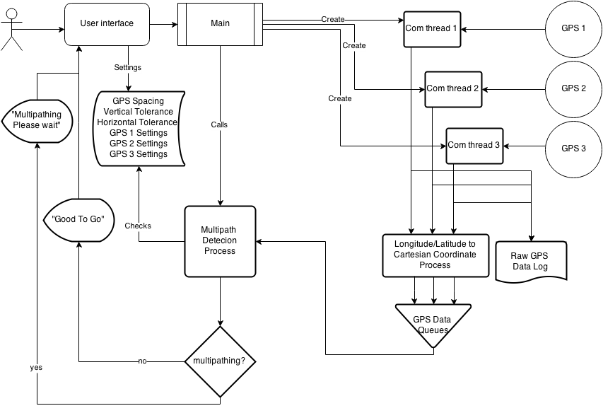
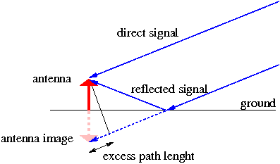
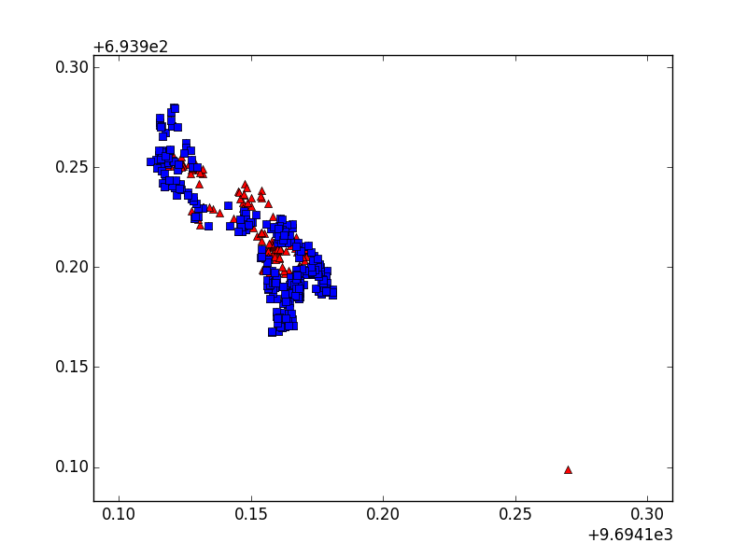
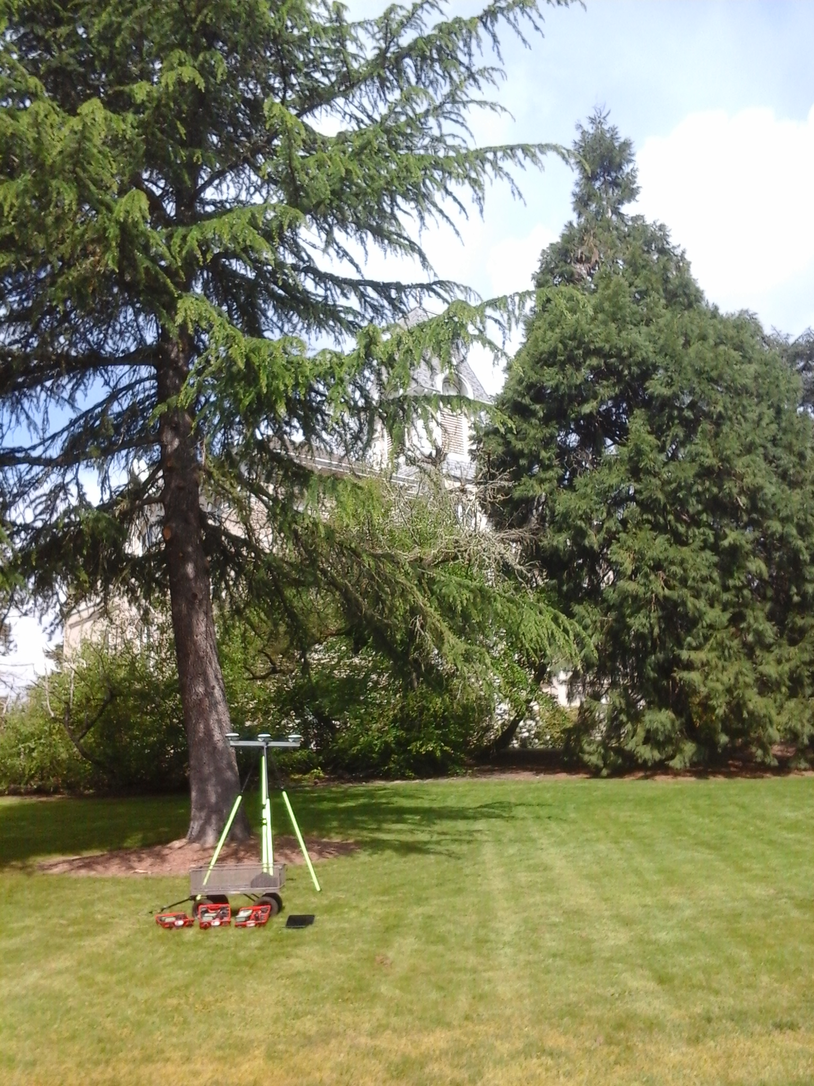
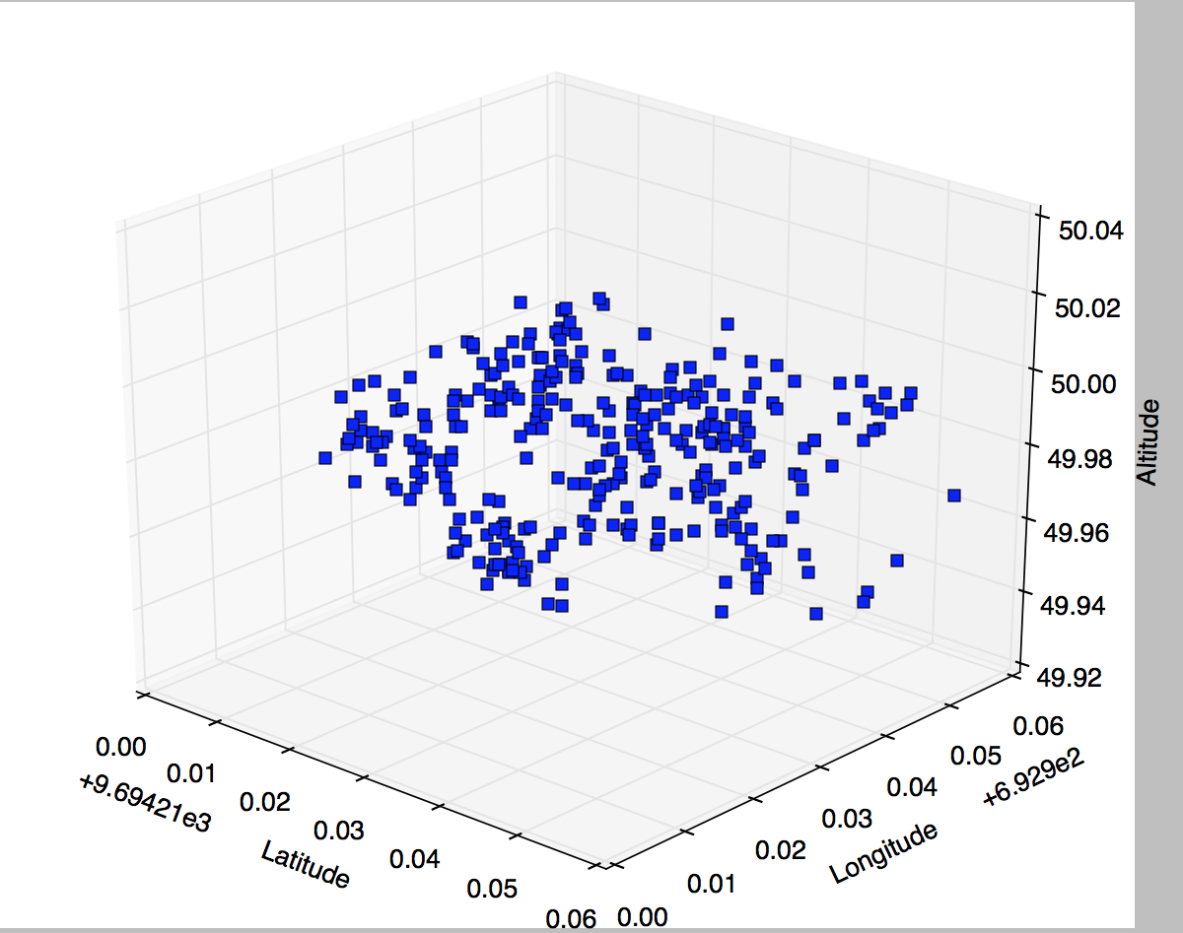
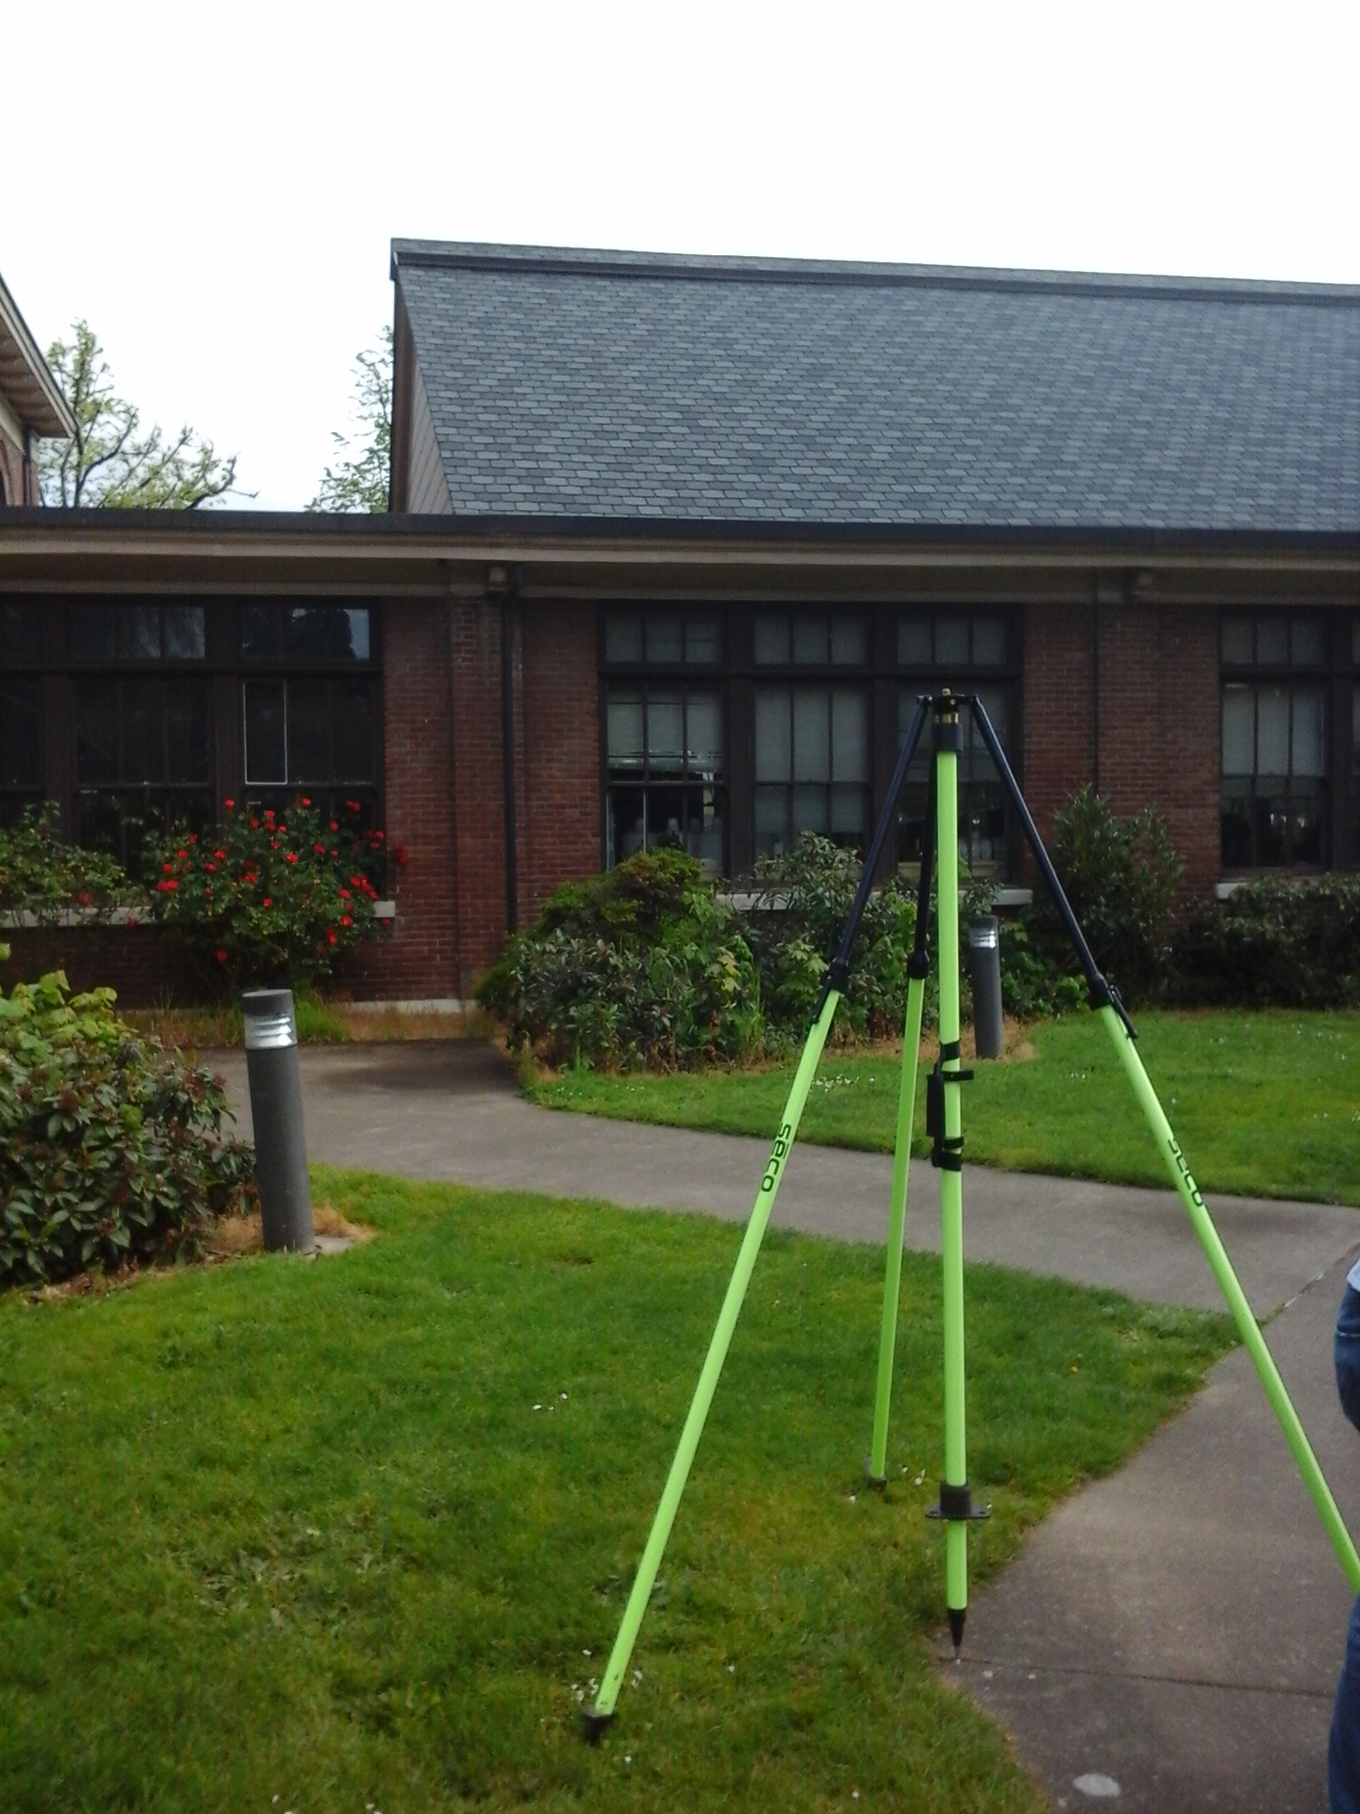
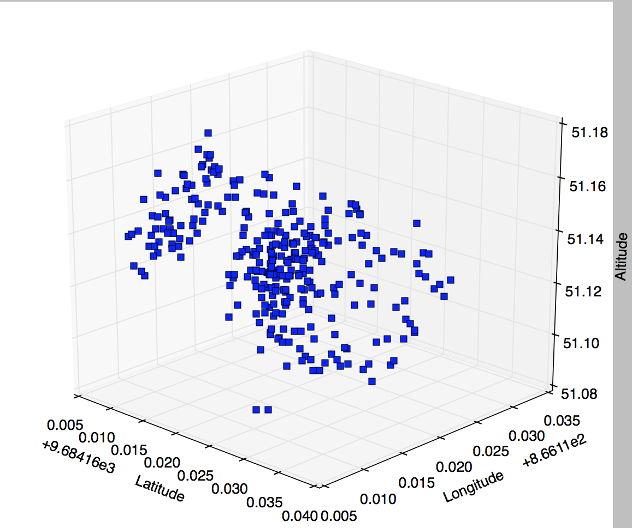

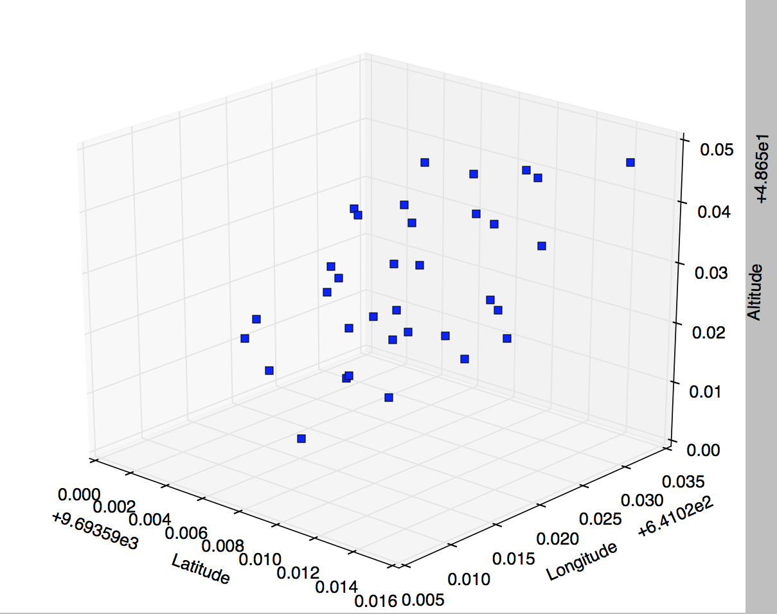
Trident : A Novel solution to Multi-pathing GPS signals
Abstract
GUI Interface
We developed an algorithm to increase the accuracy of GPS data collected near obstructions. The algorithm stacks data collected by each GPS
units into separate queues. Then, for each data point in the queue, we check if the data multi-path by testing them with various statistical tests. Finally, if the data meets the tests’ requirements, the data is marked as good and displayed to the user. We were able to field test the algorithm and collect accurate results.
Albert Le, Nathan Christopher, and Daniel Lin
Algorithm Flowchart
Background
Obstructions can reflect GPS signals away from the surveyors. We call this phenomenal multi-pathing. This can cause problems to the quality of the data collected.
Currently, if there are multi-pathing in the data, surveyors need to throw away the entire set of data and recollect them again.
Currently, there are no existing methods that can solve this problem.
The goal of this project is to solve the problem of multi-pathing.
Conclusion
Our algorithm is able to filter multi-pathing signals through our algorithm
Future works includes further testing of the algorithm to increase accuracy
More extensive field tests to get more feedback from surveyors.
Results
Meet the team
Figure 4. Unanalyzed Data (Red) overlaid by analyzed Data (Blue)
Figure on the left is control point 2, where it contains a mixture of multi-pathing and non-multipathing signals. The number of clean data points we have in our graph is less than control point 1.
Figure 1: A visual representation of multi-pathing. When signals get reflected by obstructions such as ground, the distance travelled by the signal is much longer than the direct signal. This reflection of signal is called multi-pathing.
Figure on the left shows control point 1. This point is known to contain very little multi-pathing signals. Figure on the fight are non-multipathing signals detected by the algorithm.
Figure 3 is control point 3, where there are lots of multipathing signals and very little clean data point. Our algorithm is able to filter through multiple multi-pathing signals.
Notes:
If tri-fold mounting at SMS – make sure no text or image is in-between the two vertical guide lines; this space will be cut away. To view the vertical guide lines: Select “View” from the main menu, select “Guides” from the pull down menu, and lastly select “Static Guides”.

